Slide 1



Getting Started
with PowerShell
Mike F. Robbins
mikefrobbins.com

Slide 2
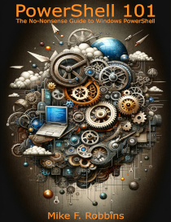



Get-Help –Name 'about_Presenter'
Mike F. Robbins
Lead docs writer for Azure PowerShell at Microsoft

Slide 3

Start-Process 'Demo'
Demo Code: github.com/mikefrobbins/Presentations

Slide 4
What is PowerShell?
An easy-to-use command-line shell, scripting language, and task automation framework
Key features
Object-oriented
Open source
Cross-platform
Extensible
Integration with .NET
Remote management

Slide 5

PowerShell versions
PowerShell 7 (pwsh)
The current version of PowerShell
Known as “PowerShell”
Installs side-by-side with Windows PowerShell (on Windows)
PowerShell 6
Formerly known as PowerShell Core
No longer supported
Windows PowerShell 5.1 (powershell.exe)
The version of PowerShell that ships with Windows

Slide 6
What are cmdlets?
Compiled commands in PowerShell
Pronounced “command-let”, not “CMD-let”
Naming convention
Singular Verb-Noun
Makes them easily discoverable
Pascal cased
Native commands in PowerShell
They exist only in PowerShell
Written in a .NET programming language such as C#

Slide 7
What are functions?
Similar to cmdlets
Written in PowerShell’s scripting language
Not written in a .NET programing lauguage
Some refer to them as script cmdlets

Slide 8
What are modules?
A group of commands packaged together
Can contain
Cmdlets
Functions
Scripts
Other resources
Group related functionality together
Extends the functionality of PowerShell
Easier to distribute

Slide 9
What are variables?
Used to store data
Can be manipulated through out a script or session
Start with a dollar sign ($)
Values assigned using the equals (=) assignment operator
Don’t use Hungarian notation
$strName
$intNumber

Slide 10
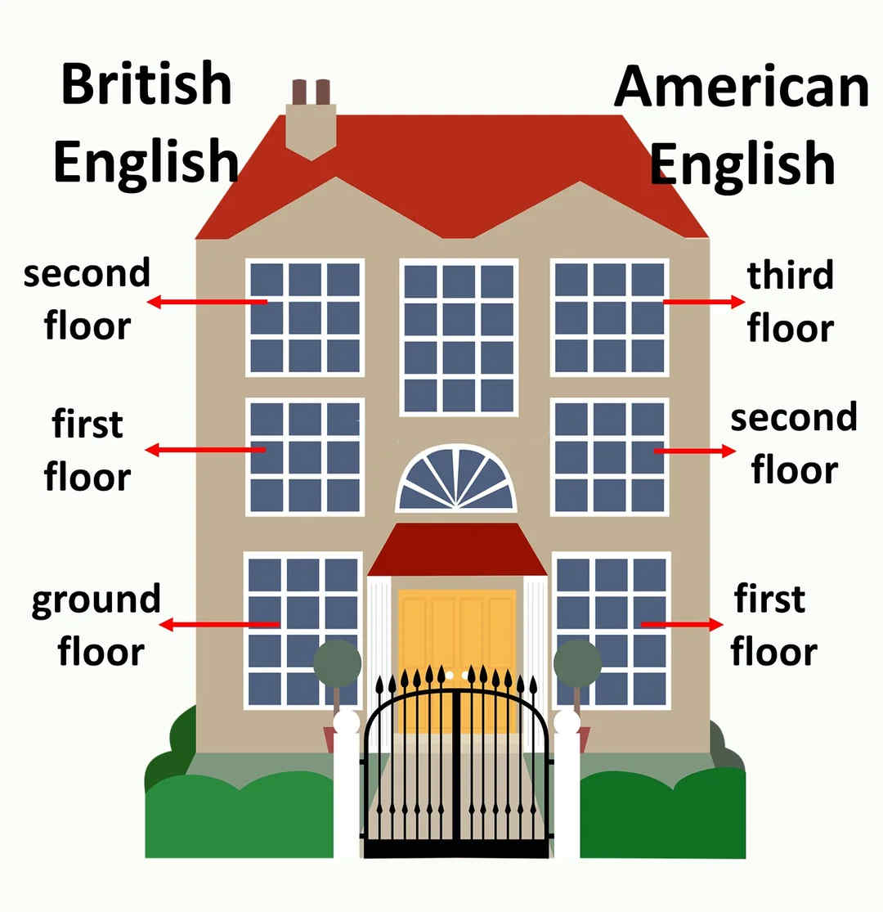
What are arrays?
Data structure that stores a collection of items
Arrays are flexible
Can hold items of different types
Zero indexed (or zero based)
The first item is index 0

Slide 11
What are hashtables?
A dictionary-like structure
Each value is associated with a unique key
Useful for storing and retrieving data
Each item can be quickly accessed using its key

Slide 12
What are script blocks?
A set of commands or expressions enclosed in curly braces {}
Can be stored in:
Variables
Passed as arguments
Used with cmdlets, such as ForEach-Object
A fundamental construct in PowerShell
Enable the creation of complex scripts and commands

Slide 13
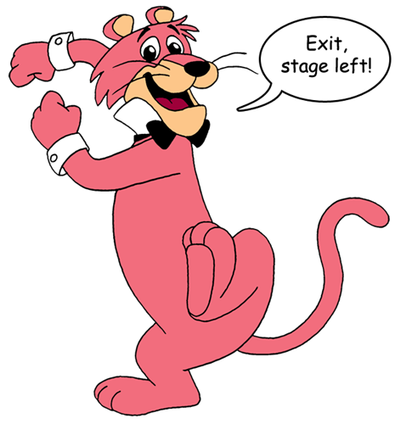
How to figure out what the commands are
Core commands for discovering how to use PowerShell
Get-Command
Find what commands are available
Get-Help
Figure out how to use commands
Get-Member
Discover objects, properties, and methods

Slide 14
Start-Process 'Demo'
Demo Code: github.com/mikefrobbins/Presentations

Slide 15
Hands-on lab for Update-Help
Update the help on your system if you haven’t done so already.

Slide 16
Hands-on lab for Get-Command
Determine the commands in the same module as Get-Process
Step 1 – Determine what module Get-Process is in
Step 2 – Return a list of the commands from that module

Slide 17
Select-Object –Property Resources
The PowerShell Best Practices and Style Guide: github.com/PoshCode/PowerShellPracticeAndStyle
The Official Product Documentation for PowerShell: learn.microsoft.com/powershell/
PowerShell.org
PowerShell Podcast: powershellpodcast.podbean.com/

Slide 18
Get-Contact –Identity 'Presenter'
Blog: mikefrobbins.com
GitHub: github.com/mikefrobbins
LinkedIn: www.linkedin.com/in/mikefrobbins
Bluesky: @mikefrobbins.com

